Slide 1
ERTOS MINIPROJECT
LIGHT INTENSITY MEASUREMENT
Group Id- 38
Shravani Deshmukh BBCO17106
Pragati Naikare BBCO17110
Deeba Shahab BBCO17152
GUIDED BY – Prof. Suvarna Patil

Slide 2




Problem Statement
Light intensity measurement using LDR sensor and Arduino on tinkerCAD.

Slide 3

System Description
Light Intensity is usually measured to control the switching on and off of the light in the Home Automation system. LDR sensor is the photoresistor that plays a major role in the Light Intensity Measurement circuit.
TinkerCad is an online simulation software for electronics circuits. Let us explore how to measure Light Intensity using LDR and Arduino

Slide 4
Hardware & Software Requirements
Arduino UNO Board.
Resistors
Breadboard
LED
Jumper Wires
LDR (Light-Dependent Resistor)
TinkerCAD

Slide 5
Code
int sensorValue=0;
void setup()
{
pinMode(A0,INPUT);
Serial.begin(9600);
pinMode(9,OUTPUT);
}
void loop()
{
sensorValue=analogRead(A0);
Serial.println(sensorValue);
analogWrite(9,map(sensorValue,0,1023,0,255));
delay(100);
}

Slide 6
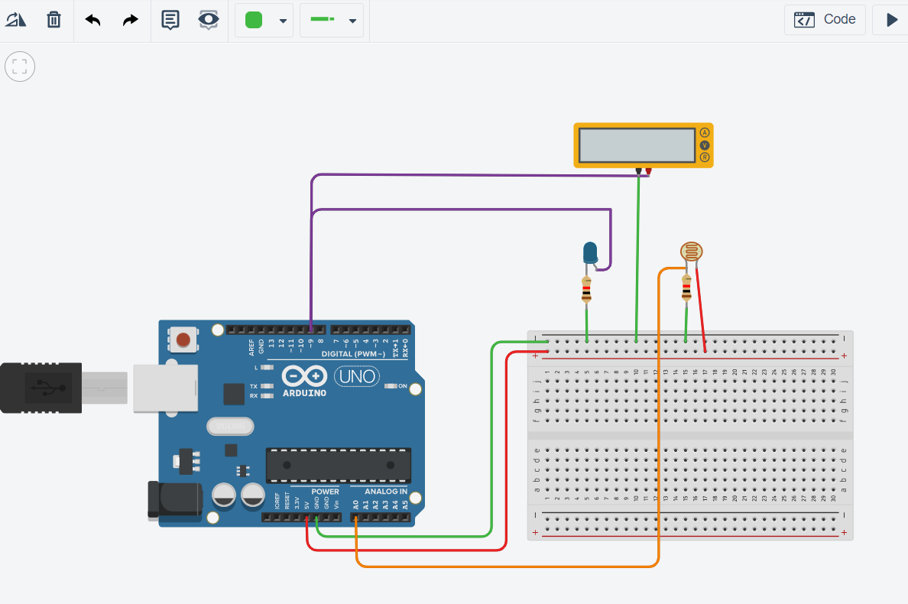
Circuit Connection

Slide 7
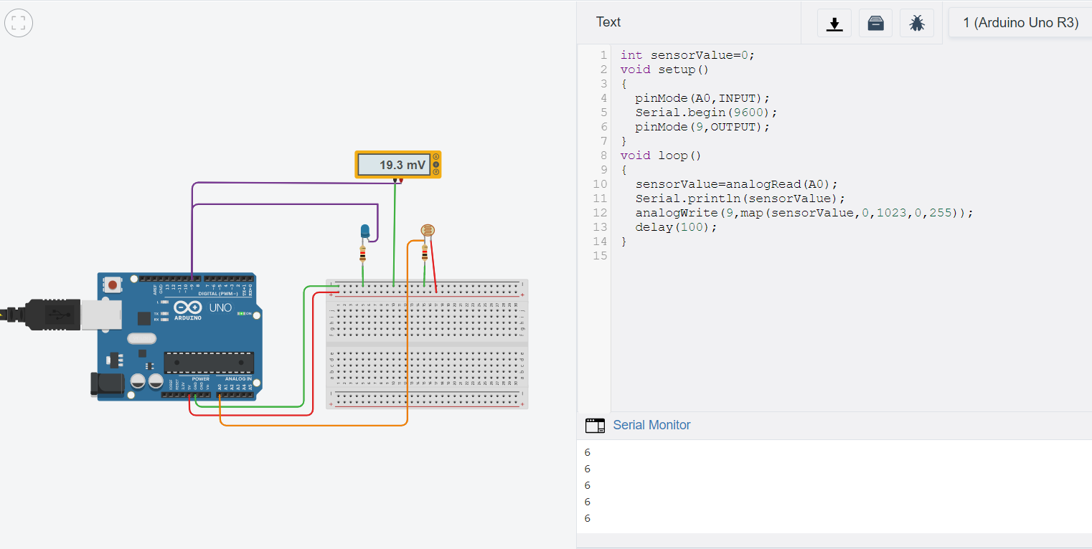
RESULT

Slide 8
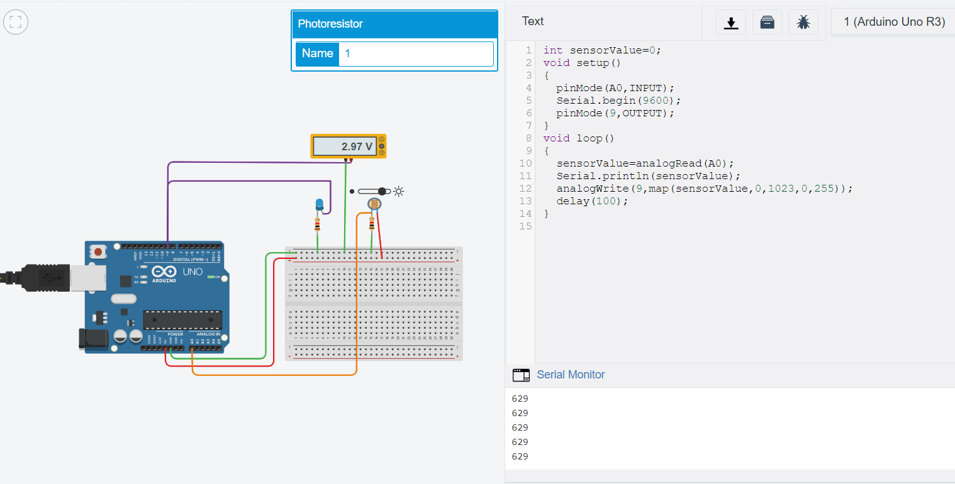

Slide 9
CONCLUSION
Hence, we have measured the intensity of light using LDR sensor and Arduino on TinkerCAD.

Slide 10

Thank You!

